Slide 1
Why Did (Almost) Nobody See It Coming and What Does That Mean for What’s Next?
Jason Furman
Harvard University
Macroeconomics Policy Seminar
February 8, 2022
(Slides lightly revised on February 10, 2022)

Slide 2
Inflation is running at the fastest pace in decades
Source: Bureau of Labor Statistics; Macrobond.

Slide 3

Why did (almost) nobody see it coming?
Source: The Royal Household.

Slide 4
Forecasts for 2021 (Q4/Q4) inflation
 | Measure | Q1 | Q2 | Q3 | Actual
SPF | Core PCE | 1.8% | 2.3% | 3.7% | 4.6%
FOMC | Core PCE | 2.2% | 3.0% | 3.7% | 4.6%
CBO | Core PCE | 1.5% |  | 2.4% | 4.6%
FRBNY DSGE | Core PCE | 1.4% | 2.2% | 3.8% | 4.6%
OECD | Core CPI |  | 3.0% |  | 5.0%
IMF | CPI* |  | 2.3% |  | 7.0%
Market-based | CPI | 2.7% | 2.9% |  | 6.7%
Note: IMF forecast is Dec/Dec.
Source: Organizations listed; author’s calculations.

Slide 5
Forecasters kept expecting inflation to slow the rest of the year, but it never did
Note: Actual inflation since projection through December 2021. Assumes that actual values were known through month prior to forecast.
Source: Bureau of Economic Analysis via Macrobond and via Federal Reserve Bank of St. Louis, ALFRED; Board of Governors of the Federal Reserve System; author's calculations.

Slide 6

A partisan echo chamber does not explain the dismissal of inflation
“[T]he ARP is poorly timed, ridiculously scaled, and horrifically designed and targeted…
Perhaps [overheating and inflation] would happen, but I doubt it. A lesson from the great inflation of the 1970s is that you have to run the economy very hot for a long time to generate significant inflation.”
--Doug Holtz-Eakin
Source: American Action Forum, Inflation and the Stimulus Debate.

Slide 7
…More like the magnitude of World War II
Largest U.S. fiscal response to an economic crisis ever
Note: Calendar year.
Source: Calculations based on Council of Economic Advisers (2014); Congressional Budget Office; Office of Management and Budget; Bureau of Economic Analysis.

Slide 8

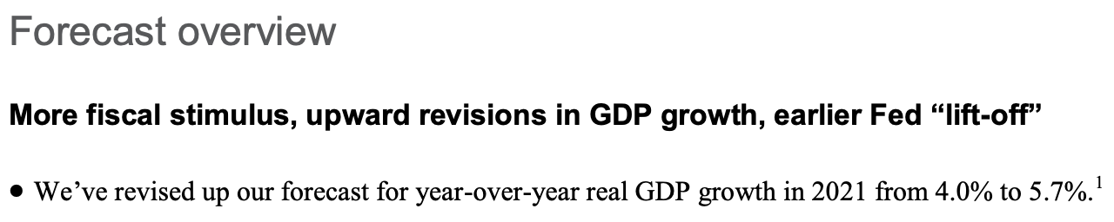
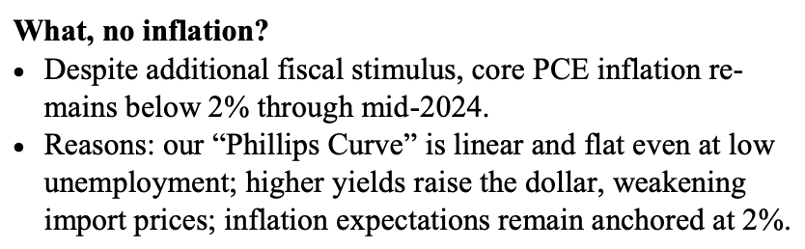
Forecasters barely updated their forecasts for the American Rescue Plan
Forecast issued on February 8, 2021
Source: IHS Markit (2021): “Executive Summary: US Economic Outlook”

Slide 9
Standard multiplier models predicted a huge increase in output
Note: Normal multipliers based on CEA (2009, 2014); low multipliers based on CBO (2020).
Source: Congressional Budget Office; IHS Markit; Council of Economic Advisers; Bureau of Economic Analysis, Macrobond; author’s calculations.

Slide 10
Predicting output would be well above pre-pandemic projections of potential
Note: Normal multipliers based on CEA (2009, 2014); low multipliers based on CBO (2020).
Source: Congressional Budget Office; IHS Markit; Council of Economic Advisers; author’s calculations.

Slide 11
This is the associated path of the predicted unemployment rate and inflation rate
Phillips curve slope = -0.17 from Ball, et. al (2021)
Note: Normal multipliers based on CEA (2009, 2014); low multipliers based on CBO (2020).
Source: Congressional Budget Office; IHS Markit; Council of Economic Advisers; Ball, et al. (2021) author’s calculations.

Slide 12
Aside: Forecasters actually assumed very high productivity instead of unemployment < 3.5%
 | 2021-Q4 IHS Markit June 2021 forecast relative to December 2019 forecast | Actual 2021-Q4 relative to IHS Markit December 2019 forecast
GDP | +2.1% | -0.9%
Employment (NFB) | -3.2% | -3.2%
Total Hours (NFB) | -2.1% | -2.6%
Productivity (NFB) | +5.4% | +2.4%
CPI | +0.9% | +4.2%
Note: Most forecasts had this property. The OECD, IMF and FOMC median (among others) projected 2021-Q4 GDP would be higher than pre-COVID projections but 2021-Q4 employment would be lower than pre-COVID projections.
Source: Bureau of Labor Statistics; Bureau of Economic Analysis; Macrobond; IHS Markit; author’s calculations

Slide 13
Using the actual path of the unemployment rate you would have predicted even less inflation
Note: Predicted based on Phillips curve model from Ball, et. al; (2021).
Source: Bureau of Labor Statistics; Congressional Budget Office; Federal Reserve Bank of Philadelphia, Survey of Professional Forecasters; Macrobond; author’s calculations.

Slide 14
As an aside, Europe had lower unemployment rates but also lower inflation
Note: HICP excluding food and energy for United States. HICP excluding energy, food, alcohol & tobacco for Euro Area.
Source: Eurostat; Bureau of Labor Statistics; Macrobond; author's calculations.

Slide 15
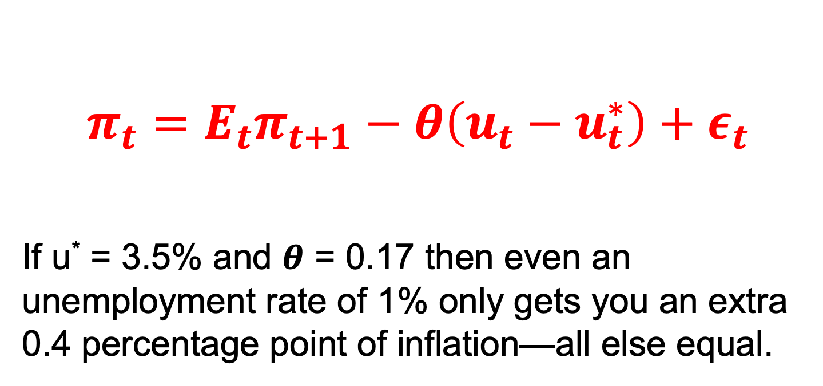
The root of the issue is that you cannot get a lot of inflation out of the standard Philips curve
$$π_{t}=E_{t}π_{t+1}−θ\left(u_{t}−u_{t}^{∗}\right)+ε_{t}$$
If u* = 3.5% and 𝜽 = 0.17 then even an unemployment rate of 1% only gets you an extra 0.4 percentage point of inflation—all else equal.

Slide 16
The linear & flat Phillips curve cannot generate much inflation even from low unemployment
Note: Based on parameters from Ball, et. al; (2021) with long-term inflation expectations of 2.5 percent and natural rate of unemployment of 4.5 percent.
Source: Calculations based on Ball, et. al; (2021).

Slide 17
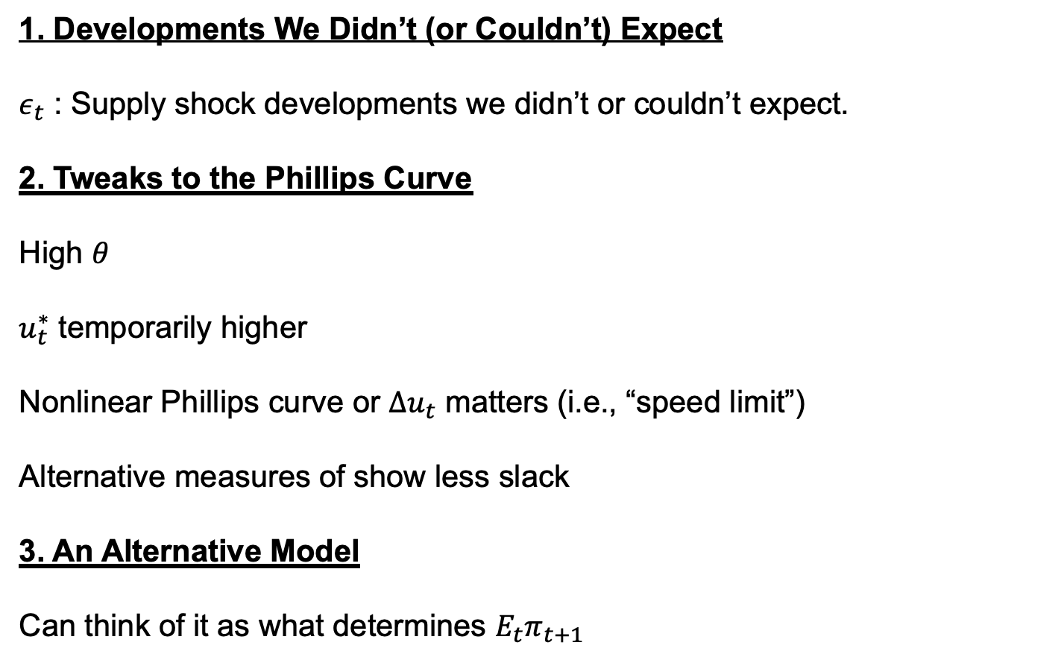
Possible ways to get more inflation
1. Developments We Didn’t (or Couldn’t) Expect
$ε_{t}$ : Supply shock developments we didn’t or couldn’t expect.
2. Tweaks to the Phillips Curve
High $θ$
$u_{t}^{∗}$ temporarily higher
Nonlinear Phillips curve or $∆u_{t}$ matters (i.e., “speed limit”)
Alternative measures of show less slack
3. An Alternative Model
Can think of it as what determines $E_{t}π_{t+1}$

Slide 18
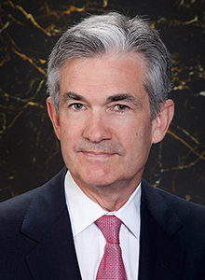
1. Developments we didn’t (or couldn’t) expect:
A. Delta slowing the reopening of the economy
“We know that we were on a path to a different place, as I mentioned, when Delta arrived. And Delta stopped, it stopped job creation. It stopped that transition away from a goods-focused economy where there’s excess demand for goods because there—services are not available. People are not traveling. That transition itself could help bring inflation down.”
--Jerome Powell
November 3, 2021
Source: Board of Governors of the Federal Reserve System.

Slide 19
1. Developments we didn’t (or couldn’t) expect:
A. But also vaccines speeding the reopening??
“So if you look, again, if you look at the, the most recent inflation report, what you see is that it came in significantly higher than expected. But essentially all of the overshoot can be tied to a handful of categories… And each of those has a story attached to it that is—that is really about the reopening of the economy.”
--Jerome Powell
July 28, 2021
Source: Board of Governors of the Federal Reserve System.

Slide 20
If anything, seems to be negative relationship between virus and inflation
Source: Bureau of Labor Statistics; Our World in Data; Macrobond; author's calculations.

Slide 21
My own impression: Delta more likely slowed inflation than increased it
Delta raised goods inflation and lowered services inflation.
The net is ambiguous.
But more likely it lowered inflation:
  That’s what happened in the initial 2020 wave
  Was the ex-ante analysis as Delta emerged
  Services prices 5X as important as goods prices
  Gasoline prices very sensitive to virus
  Omicron event study on TIPS market predicted this
  Regardless, likely not a very large positive or negative for inflation.

Slide 22
1. Developments we didn’t (or couldn’t) expect:
B. Shift of consumption from services to goods
Likely caused some temporary elevation of inflation but: (1) much of higher goods consumption appears to be due to stimulus checks not a COVID taste shock and (2) only higher inflation to the degree goods supply is more inelastic than services supply.
Note: Pre-pandemic trend based on log-linear regression for Jan-18 to Dec-19.
Source: Bureau of Economic Analysis; Macrobond; author's calculations.

Slide 23
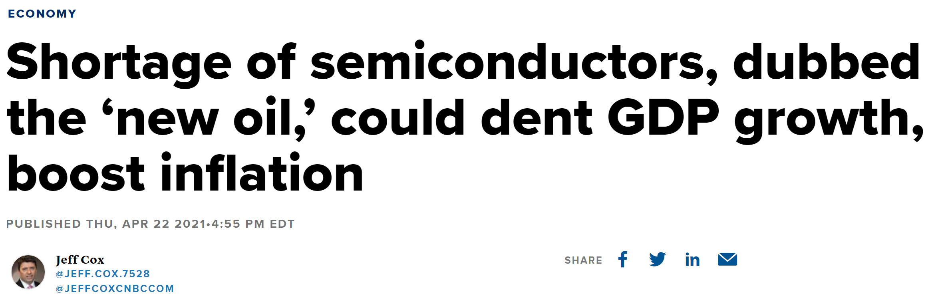
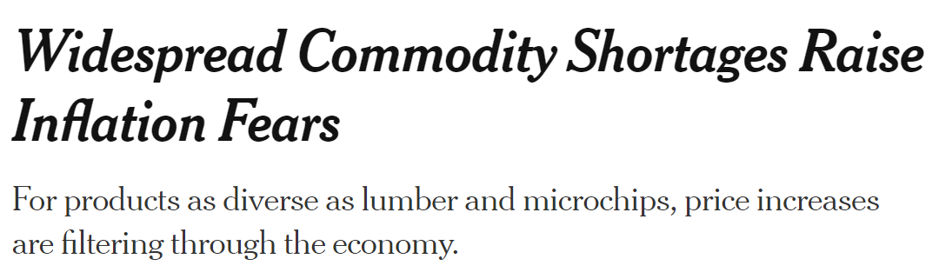
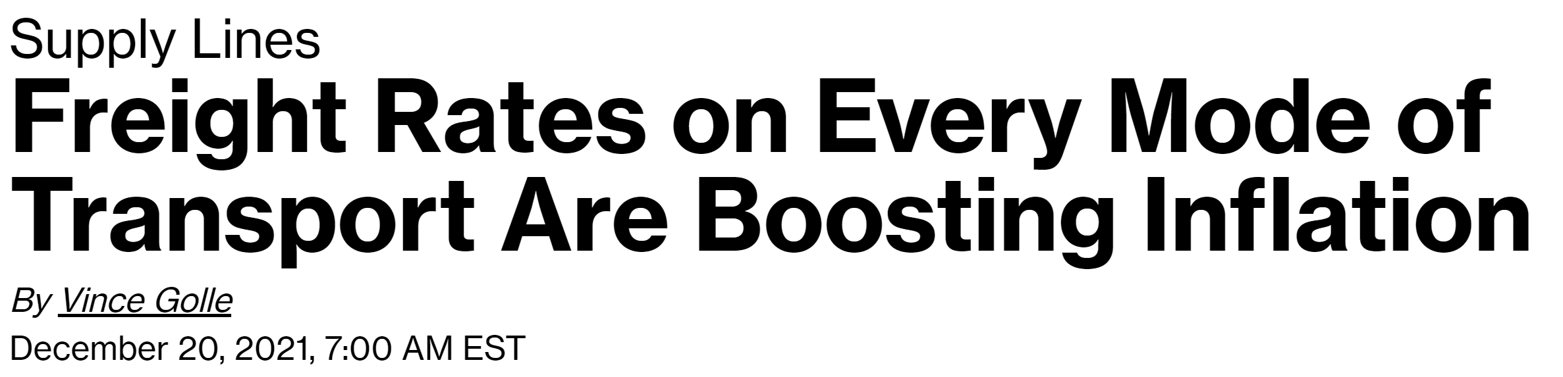
1. Developments we didn’t (or couldn’t) expect:
C. Supply chains
Source: CNBC; The New York Times; Bloomberg.

Slide 24
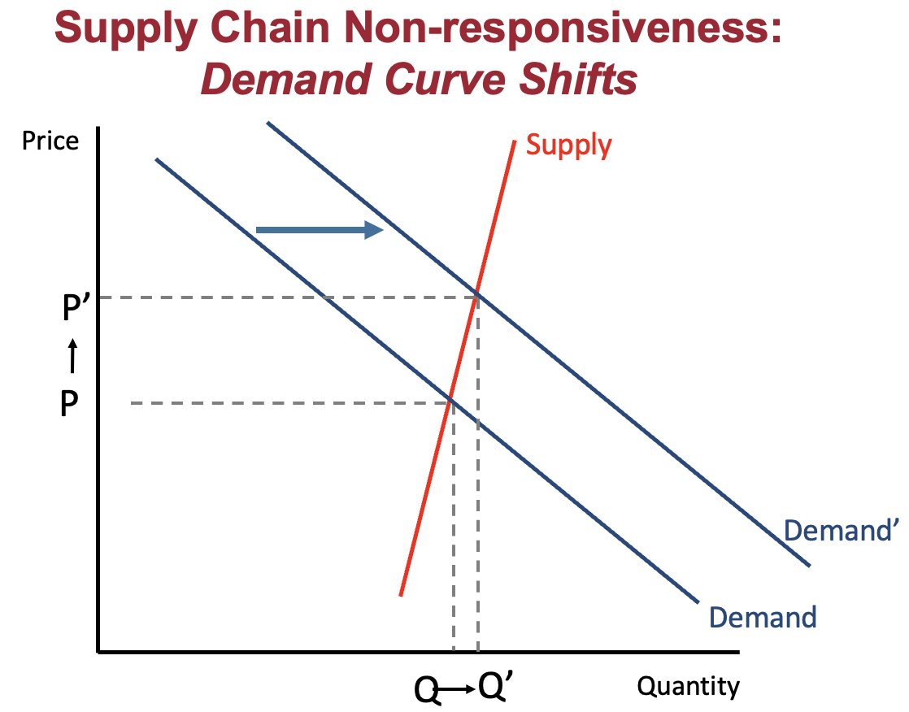
But supply generally increased—really is more of a demand shock than a supply shock
Note: Full and empty container imports for Ports of Los Angeles, Long Beach, New York & New Jersey, Savannah, and Seattle & Tacoma.
Source: Ports authorities; Macrobond; author's calculations.

Slide 25
1. Developments we didn’t (or couldn’t) expect:
D. The “Great Resignation”
Note: Gray lines depict paths in prior recessions since 1948.
Source: Bureau of Labor Statistics via Macrobond; Dynan and Powell (2022).

Slide 26
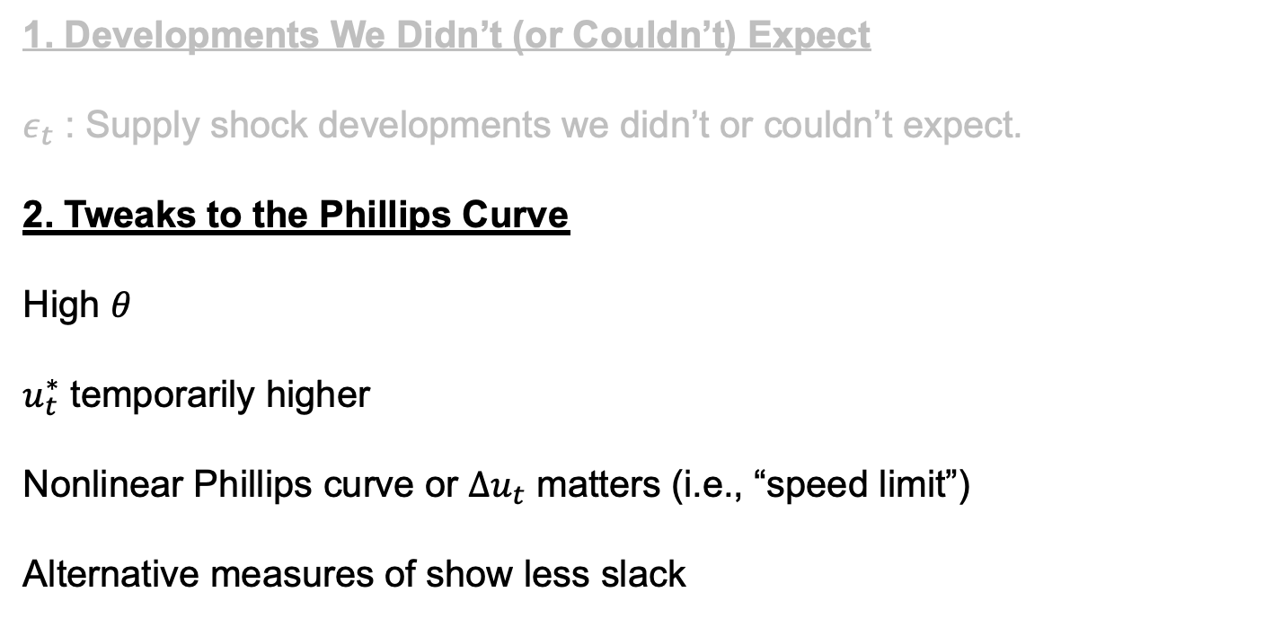
Possible ways to get more inflation
1. Developments We Didn’t (or Couldn’t) Expect
$ε_{t}$ : Supply shock developments we didn’t or couldn’t expect.
2. Tweaks to the Phillips Curve
High $θ$
$u_{t}^{∗}$ temporarily higher
Nonlinear Phillips curve or $∆u_{t}$ matters (i.e., “speed limit”)
Alternative measures of show less slack

Slide 27
2. Tweaks to the Phillips Curve:
Steeper curve or temporarily higher NAIRU
Steeper Phillips Curve
Maybe flatness is conflating systematic changes in expected inflation with genuine flatness, local Phillips curves generate steeper estimates (e.g., Struyven 2017 and Hazell, Herreño, Nakamura, and Steinsson 2021)
Temporarily higher NAIRU
Even if the true pre-pandemic NAIRU was 3.5 percent could not have gotten to 3.5 percent inflation in, say, April 2021.
Hysteresis temporarily raises the NAIRU
Pandemic-specific factors, generous unemployment insurance, and jobs resorting also temporarily increased the NAIRU.

Slide 28
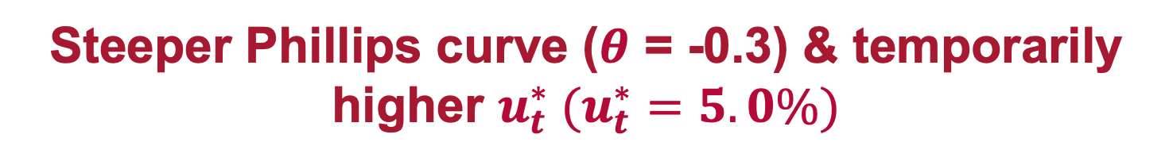
Steeper Phillips curve ($θ$ = -0.3) & temporarily higher $u_{t}^{∗} (u_{t}^{∗}=5.0\%)$
Source: Bureau of Labor Statistics; Congressional Budget Office; Federal Reserve Bank of Philadelphia, Survey of Professional Forecasters; Macrobond; author’s calculations.

Slide 29
2. Tweaks to the Phillips Curve:
Nonlinear or speed limit
Some research has found this (e.g., Nalewaik 2016 and Fair 2021).
An unsatisfying way to generate precise predictions. Why have we not hit it before when the unemployment rate has fallen gradually?
Maybe a good reason to expect higher inflation than the basic Phillips curve would give you?
Note: can think of a speed limit as isomorphic to a temporary increase and gradual decline in the NAIRU.

Slide 30
2. Tweaks to the Phillips curve:
Alternative measures of slack
Note: Measures standardized using mean and standard deviation from 2001 through 2018. Prime-age nonemployment is the share of the civilian population aged 25-54 that is not employed. Unemployment rate is the U-3 unemployment rate. The quits rate is quits divided by total nonfarm employment.
Source: Bureau of Labor Statistics via Macrobond; author’s calculations.

Slide 31
The prior two decades should have told us to pay attention to alternative slack measures
Predictor | Predicting Core CPI: Adjusted R² from Phillips Curve Regression
Quits | 47%
Unemployed / Job Opening | 45%
Unemployment Rate | 35%
Prime-age Employment Rate | 22%
Note: Shows prediction for year-ahead core CPI inflation regressed on last year’s core CPI inflation and the current value of the predictor variable. See paper for more analysis.
Source: Furman and Powell (2021), https://www.piie.com/blogs/realtime-economic-issues-watch/what-best-measure-labor-market-tightness.

Slide 32
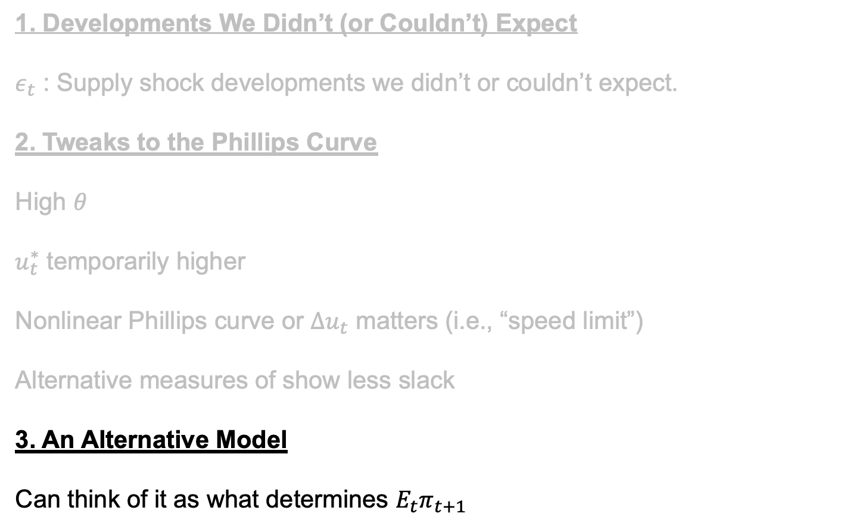
Possible ways to get more inflation
1. Developments We Didn’t (or Couldn’t) Expect
$ε_{t}$ : Supply shock developments we didn’t or couldn’t expect.
2. Tweaks to the Phillips Curve
High $θ$
$u_{t}^{∗}$ temporarily higher
Nonlinear Phillips curve or $∆u_{t}$ matters (i.e., “speed limit”)
Alternative measures of show less slack
3. An Alternative Model
Can think of it as what determines $E_{t}π_{t+1}$

Slide 33
3. An alternative model
A thought experiment
Suppose you gave everyone a helicopter drop of $1,000,000.
IF you used a Phillips curve with unchanged inflation expectations at most this would lead you to predict about 3 percent inflation.
Is it better to think of this policy as changing inflation expectations than operating through supply and demand in the labor market?
In general, inflation rates vary a lot across countries and over time in ways not at all related to the degree of slack.

Slide 34
Model nominal GDP + real GDP inelastic, prices are the residual
A simple model for 2021:
Use multipliers and other standard methods to predict nominal GDP
Use productive capacity of the economy adjusted down for pandemic to predict real GDP (simplification assuming real GDP is inelastic)
Price increases are the residual

Slide 35
Quantifying: Inflation ~1-4pp higher in 2021 and ~0-2pp higher in 2022???
Note: Normal multipliers based on CEA (2009, 2014); low multipliers based on CBO (2020).
Source: Congressional Budget Office; IHS Markit; Council of Economic Advisers; author’s calculations.

Slide 36
As an aside, Europe appears to have had much less fiscal stimulus
Note: Pre-pandemic trend based on log-linear regression for 2018Q1 to 2019Q4.
Source: Bureau of Economic Analysis; INSEE; Statistisches Bundesamt; Macrobond; author’s calculations.

Slide 37
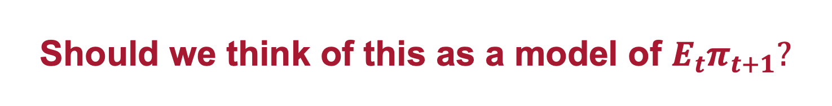
Should we think of this as a model of $E_{t}π_{t+1}?$
Sticking with the Phillips curve can think of this as a model for expected inflation, maybe the fiscal theory of the price level?
But, hard to have specific predictions from this approach. And why would it change the rate not the level?
Plus, expectations have not shifted very much.
So maybe best to think of this as mapping in to a nonlinear Phillips curve after all.
Source: Macrobond.

Slide 38
Bottom line
Inflation was likely higher because of unexpected factors but probably not much higher.
Tweaks to a Phillips curve could generate a little more inflation (e.g., steeper curve, alternative measures of slack).
In general a nonlinear Phillips curve is fragile and hard to use for prediction, but with very large changes it is reasonable using a model where fiscal stimulus raises nominal GDP, real GDP can only rise so far, and the residual is prices.

Slide 39
Looking forward:
Four reasons for inflation to moderate
People shift from buying goods to services
People return to the workforce
Global supply chains unsnarl
Major monetary/fiscal support over

Slide 40
We have mostly had goods inflation
Source: Bureau of Labor Statistics; Macrobond; author’s calculations.

Slide 41
But services inflation is picking up
Source: Bureau of Labor Statistics; Macrobond; author’s calculations.

Slide 42
A broader set of inertial measures of inflation are also picking up
Source: Bureau of Economic Analysis; Federal Reserve Banks of Atlanta, Dallas, and Cleveland; Macrobond; author’s calculations.

Slide 43
Returning to the workforce may not be a panacea
If the age-adjusted labor force participation rate rises to its pre-pandemic value by December 2022 then:
The labor force participation rate would rise by ~0.9 percentage point.
For context, the labor force participation rate rose by an average of 0.8 percentage point annually from December 1975 to December 1978.
To the degree the increase is all labor supply could think of this as the NAIRU falling by a small amount with translates into a relatively small downward pressure on inflation.

Slide 44
Five reasons for inflation to increase
Other micro stories playing out like shelter

Slide 45
Price of shelter and other services set to rise
Note: Data for January 2022, except for Apartment Guide; CPI; Realtor.com, Yardi, and Zillow (December 2021), CoreLogic (November 2021), and U.S. Census Bureau (2021Q4).
Source: Apartment List National Rent Report, Bureau of Labor Statistics (CPI, Rent of Primary Residence), U.S. Census Bureau (Median Asking Rent), Zillow Observed Rent Index via Macrobond; Apartment Guide Rent Report (2-bedroom); CoreLogic Single-Family Rent Index; Realtor.com Median Rent; Yardi Multifamily Average Asking Rents; author's calculations.

Slide 46
Five reasons for inflation to increase
Other micro stories playing out like shelter
Labor markets have tightened
  An additional ~0.5 p.p. more in inflationary pressure
  Nominal wages growing at 5+ percent
Inflation expectations higher
  Expectations 1 to 3 p.p. higher
Demand continues to be above trend and supply below trend (COVID reduction could boost demand more than it increases supply)

Slide 47
Still a lot of excess savings
Note: Pre-pandemic trend based on log-linear regression for Jan-18 to Dec-19.
Source: Bureau of Economic Analysis; Macrobond; author’s calculations.

Slide 48
Monetary policy is much looser than a Taylor Rule
 | Taylor | Doveish | Inertial Doveish
r* | 0.5% | 0.0% | 0.0%
u* | 4.0% | 3.5% | 3.5%
Inertia Parameter | 0.0 | 0.0 | 0.8
Weight on Output Gap | 0.5 | 1.0 | 1.0
Q4 Forecast | UR | π
2022 | 3.5% | 2.6%
Source: Federal Reserve Bank of Cleveland; Federal Reserve Bank of New York; Board of Governors of the Federal Reserve System; Bureau of Labor Statistics; Bureau of Economic Analysis; author’s calculations.

Slide 49
Five reasons for inflation to increase
Other micro stories playing out like shelter
Labor markets have tightened
  An additional ~0.5 p.p. more in inflationary pressure
  Nominal wages growing at 5+ percent
Inflation expectations higher
  Expectations 1 to 3 p.p. higher
Demand continues to be above trend and supply below trend (COVID reduction could boost demand more than it increases supply)
Manageable endemic COVID in United States plus COVID-zero in China as inflationary???

Slide 50
But I’m very uncertain: my subjective probability distribution for 2022 core PCE
Core PCE (2022-Q4/Q4) | Probability
< 1% | 3%
1 – 2% | 12%
2 – 3% | 23%
3 – 4% | 32%
4 – 5% | 20%
> 5% | 10%
Mean | 3.3%

Slide 51
Will inflation be higher in 2023 relative to 2022?
Reasons inflation could be lower
Less loose monetary policy and further removed from fiscal policy lags
Potential could expand as supply chains solved and labor returns
Reasons inflation could be higher
Inflation could be artificially lowered in 2022 by supply shocks (e.g., some mean reversion in car prices).
Could have tighter labor markets and higher inflation expectations
The near universal assumption of forecasters is that inflation in 2023 < inflation in 2022. I would put less than 40 percent of that. This could matter a lot.

Slide 52
My ranking of outcomes from best to worst
Smooth transition to a higher inflation target. Inflation ends up around 3 percent, nominal wage growth rises commensurately, Fed updates framework.
Smooth transition to 2% inflation. What the Fed believes will happen.
Inflation < 2%. Long-term structural forces mean inflation falls below the Fed’s 2 percent goal.
Inflation sustained above 4%. No happy ending in this scenario.
Fed causes a recession to get inflation back to 2%. A lot of historical examples of this.

Slide 53
Why Did (Almost) Nobody See It Coming and What Does That Mean for What’s Next?
Jason Furman
Harvard University
Macroeconomics Policy Seminar
February 8, 2022
(Slides lightly revised on February 10, 2022)

